Slide 1
LinkedIn Edunet
FacultyBalance-AI Assisted Faculty Time Allocation
P R E S E N T A T I O N 2 0 2 6
👤
Student Name
✉
Student Email
[Dr Rama Mokkarala]
[chrama.24@gmail.com]
📖
[Mr Adarsh]

Slide 2
edunet
foundation
OUTLINE
• Abstract of the Project
• Problem Statement
• Proposed Solution
• System Architecture
• Live Demo of the Project
• Embedded Video of Project
• Conclusion
• Future Scope

Slide 3
edunet
foundation
Abstract
• Purpose of the Project:The current project develops a unified dataset that consolidates all components of faculty workload, quantifies imbalances at individual and departmental levels, and proposes redistribution strategies to enhance equity and protect research time
• Tools & Technologies Used: Excel + Power BI + Copilot are used
• Outcomes: A Unified and cleaned Dataset. The dataset to be used to build an interactive Dashboard visualizing the distribution at individual and Departmental levels. The analysis identifies specific faculty and departments for potential redistribution and models how reallocating service duties can increase available research hours.
•
.
• Key Aspect: Ccomprehensive workload summaries that consolidate all teaching and service components are essential to prevent faculty burnout and to foster research productivity. Adoption of the project’s metrics and redistribution recommendations will enable fairer workload allocation and strengthen departmental research capacity.

Slide 4
edunet
foundation
Problem Statement
• Core Problem: Institutions lack a unified and data-driven mechanism to evaluate and balance faculty workload across teaching, research, and administrative responsibilities. Existing workload allocation practices are fragmented, manually managed, and often based on static timetables or subjective judgment. .
• Significance of Problem: The absence of a centralized analytical system prevents institutions from identifying workload imbalances, benchmarking against expected norms, and making informed redistribution decisions. .
• Affected: Faculty members of higher Education institutions
• State limitations of existing approaches or tools.
Scope : The analysis focuses on Unified Real Time Data collection, data cleaning, visualization, report generation, and AI assisted insights generation using prompt engineering.
Boundaries: The project does not include the simulated what -if scenarios and real time data integration.
.

Slide 5
edunet
foundation
Proposed Solution
To develop a unified dataset capturing faculty teaching, research, and administrative responsibilities for accurate workload analysis.
To clean and preprocess the workload data, removing inconsistencies, standardising categories, and ensuring completeness
To design an interactive Power BI dashboard that visualizes workload distribution at individual & departmental levels and provides Teaching KPIS, Service Hours KPIs and Balance KPIs
To integrate AI and generate workload summaries at individual and departmental levels that can highlight imbalances if any and facilitate predictive modelling
Methodology & Tools Key Advantages
Data Ingestion | Loading the raw dataset into Excel
Data Cleaning | Removing inconsistencies, duplicates, and null values using Power query editor and Excel
Data Analysis | Applying calculations, formulae, AI prompts, or DAX measures.
Visualization / Report Generation | Building dashboards, charts using Power BI
AI Integration | Using Copilot for analysis, content generation, or insight summaries.
Cost-effective | Improved Research Time Allocation
Comprehensive Workload Visibility | Enhanced Decision Support
Early Imbalance Detection | Fairness and Morale
Data Driven Redistribution | Leverages AI tools like Copilot to accelerate analysis and reduce human error

Slide 6
edunet
foundation
System Architecture
Data Input / Source
Processing / Analysis
Real Excel Dataset with 109 rows and 25 columns capturing faculty from 6 different Departments across 3 designations and 3 experience Levels.
Primary sources: Departmental workload documents and timetables submitted by HODs; IQAC committee allocation sheet; manual data entry for non‑digital inputs; verification records signed by the Principal.
Used Power Query to normalize text and numeric formats, deduplicate records, and harmonize field names & replace null values
Apply business rules and assumptions (e.g., 1 class = 1 hour; mentoring = 1 hr/week; class of 60 = 1 proportion unit; new/repeat flags = 1/0; same‑subject sections flag = 1). Computed derived fields: TSH, TH, EL (Junior/Mid/Senior), Course Load Flag (High/Low), Check_Total, Error_Flag.
Used Power BI for dashboard development
AI / Tool Integration
Output / Dashboard
Excel used for Data input and cleaning using Power query editor.
Power BI to develop visualizations Dashboard
Copilot was used to generate insightful summaries for actionable insights and suggestion for incorporation of important metrics.
The final output is Dashboard with Departmental KPIS, Teaching KPI, Research & Admin KPIs and Balance KPIS showing allocations for faculty with different experience levels , citing imbalances and suggesting reallocation to ensure fair distribution of workload and increase research hours.

Slide 7
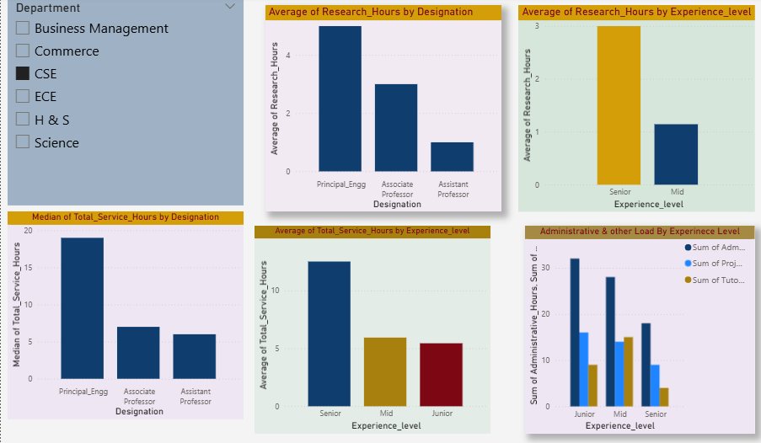
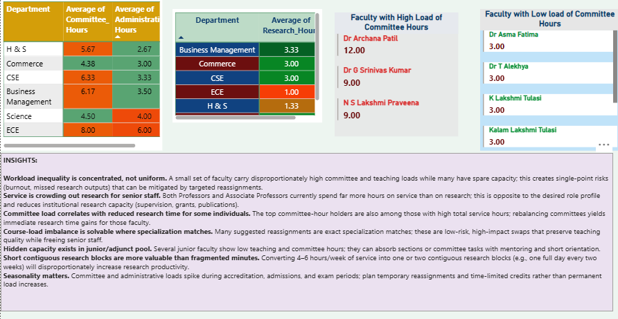
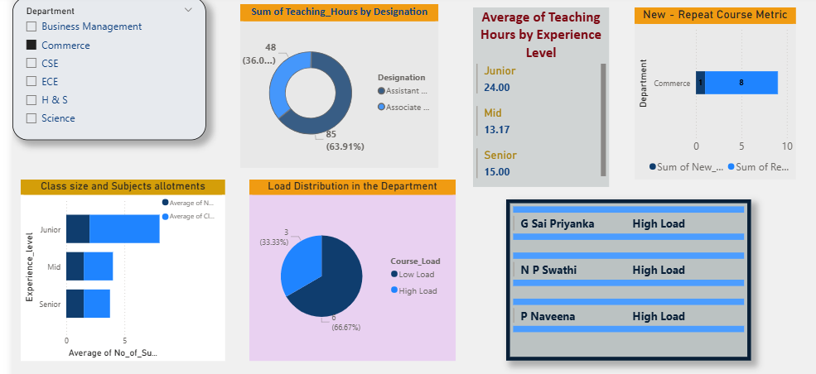
edunet
foundation
Live Demo of Project
Here's the list of some demo screenshots / features of the project:
🖼
🖼
🖼
Demo 1
Demo 2
Demo 3
Teaching KPIs: Department‑wise teaching load distribution, new course allocations, and class size are highlighted. The dashboard shows load balance across faculty, total teaching hours by designation, and average teaching hours by experience level. High‑load faculty are clearly visualized for quick identification.
Faculty research hours are shown by experience level and designation, alongside median and total service hours. Administrative loads are categorized by experience, giving a clear view of balance and alignment with institutional norms
Department wise averages of research, service, and administrative hours are shown, highlighting correlations between low research and high service loads. High load and low load faculty are identified, with AI generated insights from Copilot guiding fair reallocation and improved research time

Slide 8
edunet
foundation
Video of Project Demo
https://drive.google.com/file/d/1hVa6s_7a4nLf5VAXvBw8Gg3SSsFTqyil/view?usp=drive_link
▶
[Insert your project demo video.
You can embed a video your live project.]

Slide 9
edunet
foundation
Conclusion
The project successfully developed a unified and cleaned dataset that integrates both teaching parameters and service components (committee, administrative, project, and mentoring hours)
The dashboards highlighted key teaching indicators such as average teaching hours, class size, and course load by designation and department, while also identifying faculty members with disproportionately high teaching responsibilities.
The dashboards captured research and service hours, revealing that reducing excessive service commitments can create opportunities to increase research productivity.
The imbalance detection and redistribution modelling offered actionable insights for fairer workload allocation.
The project further benefited from AI‑assisted insights through Copilot, which enriched the analysis with interpretive commentary and practical suggestions.
Overall, the project contributes to fair and equitable workload distribution, which enhances faculty satisfaction, reduces stress, and strengthens the institution’s research and teaching capacity.
All the Objectives of the project were met
✅
CONCLUSION

Slide 10
edunet
foundation
Future Scope
🧠
Integrate real-time data pipelines using Power Automate or API connections.
Apply machine learning models (e.g., forecasting, anomaly detection) on top of the cleaned dataset.
Build a web-based interface or Power Apps solution for non-technical end users
The incorporation of normalization models taking the policy guidelines of institutes as input.
To develop a chatbot interface to have a conversational flow assistance to detect imbalances and take actionable insights.
To develop a tool for faculty to check their workload and understand if they are within the limits specified.

Slide 11
edunet
foundation
Thank You
AICW Fellowship | Student Project Presentation 2026
LinkedIn | Edunet Foundation

